Slide 1



Parallel, Perpendicular or Neither
True/false
Reflect
Your Turn
Rule

Slide 2
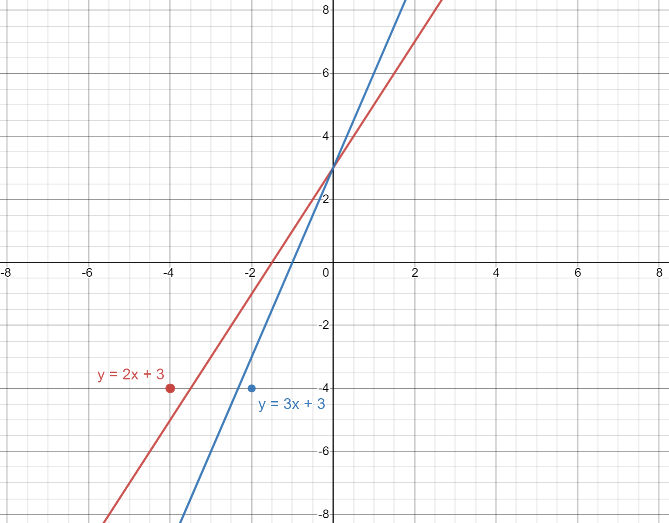
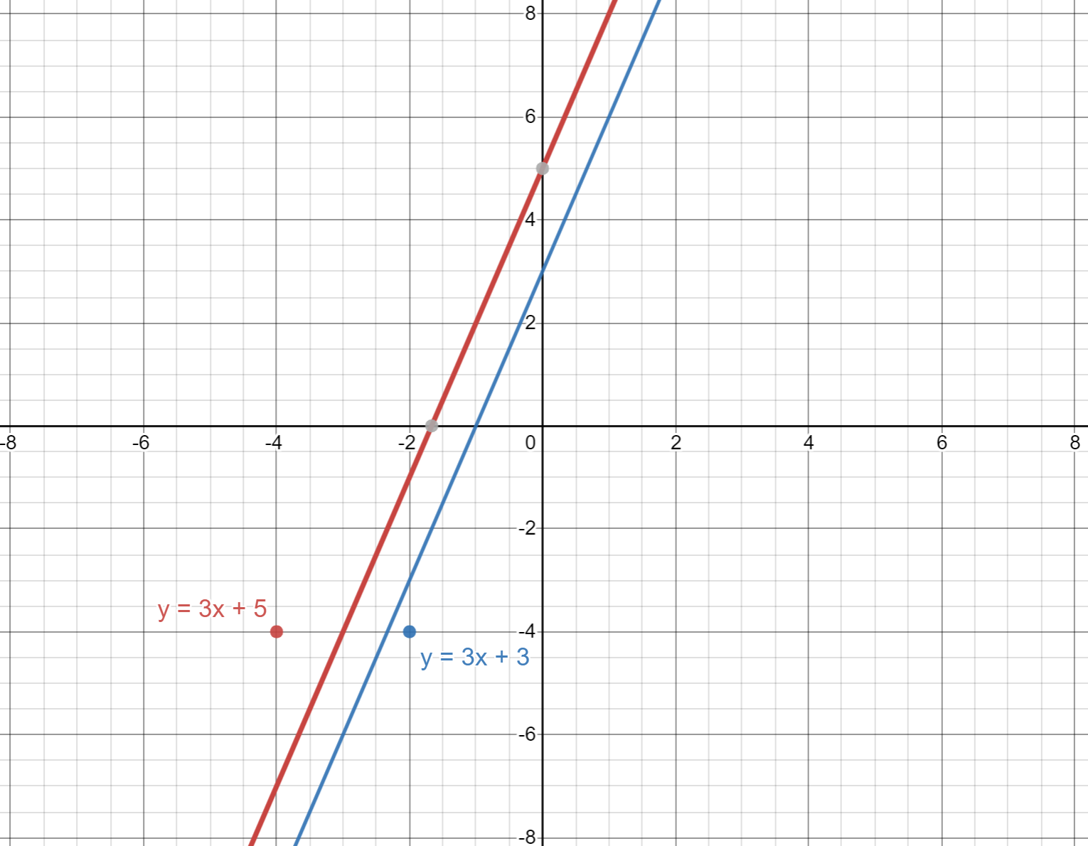
Are these lines Parallel, Perpendicular or Neither?
Neither
Parallel

Slide 3
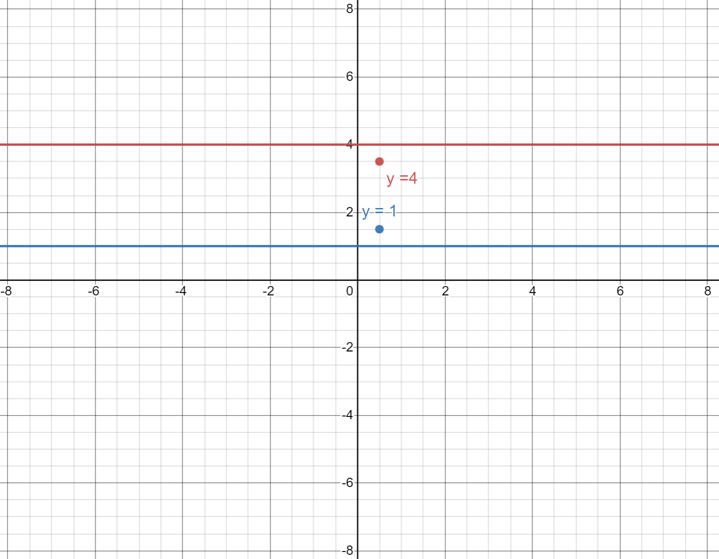
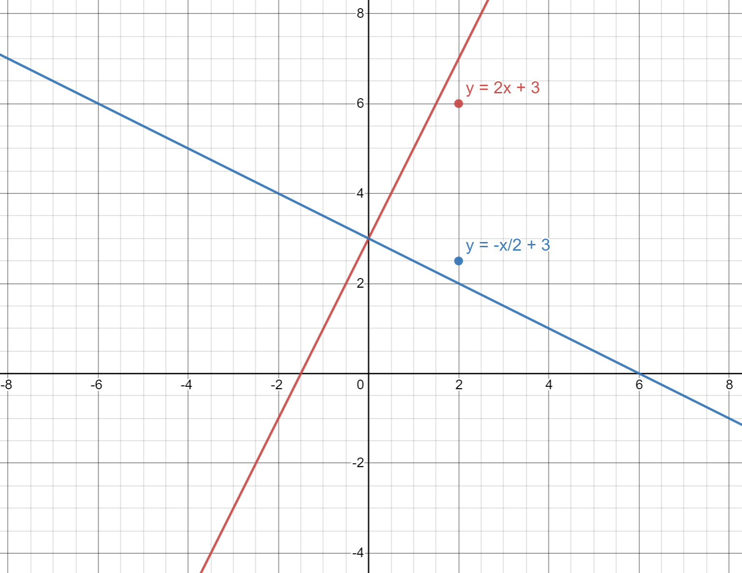
Are these lines Parallel, Perpendicular or Neither?
Parallel
Perpendicular

Slide 4
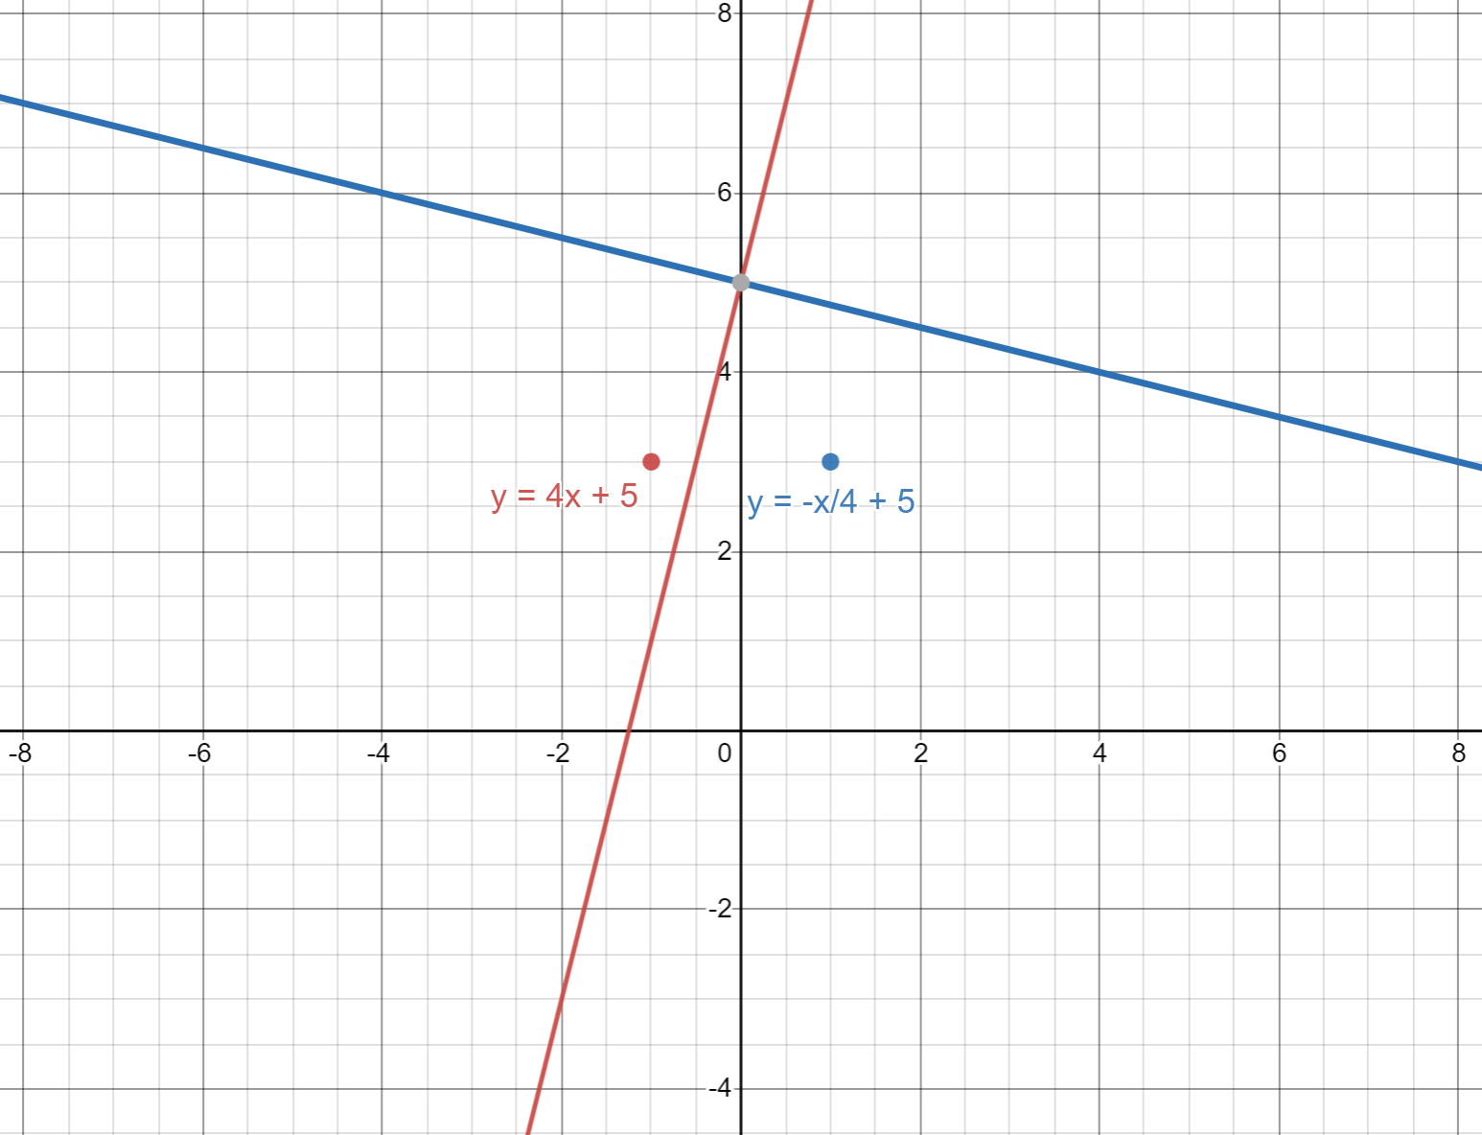
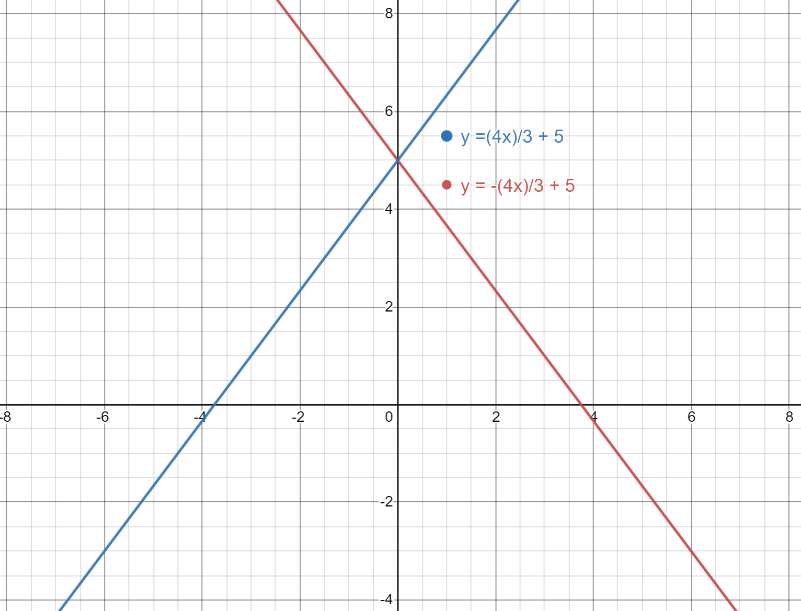
Are these lines Parallel, Perpendicular or Neither?
Perpendicular
Neither

Slide 5
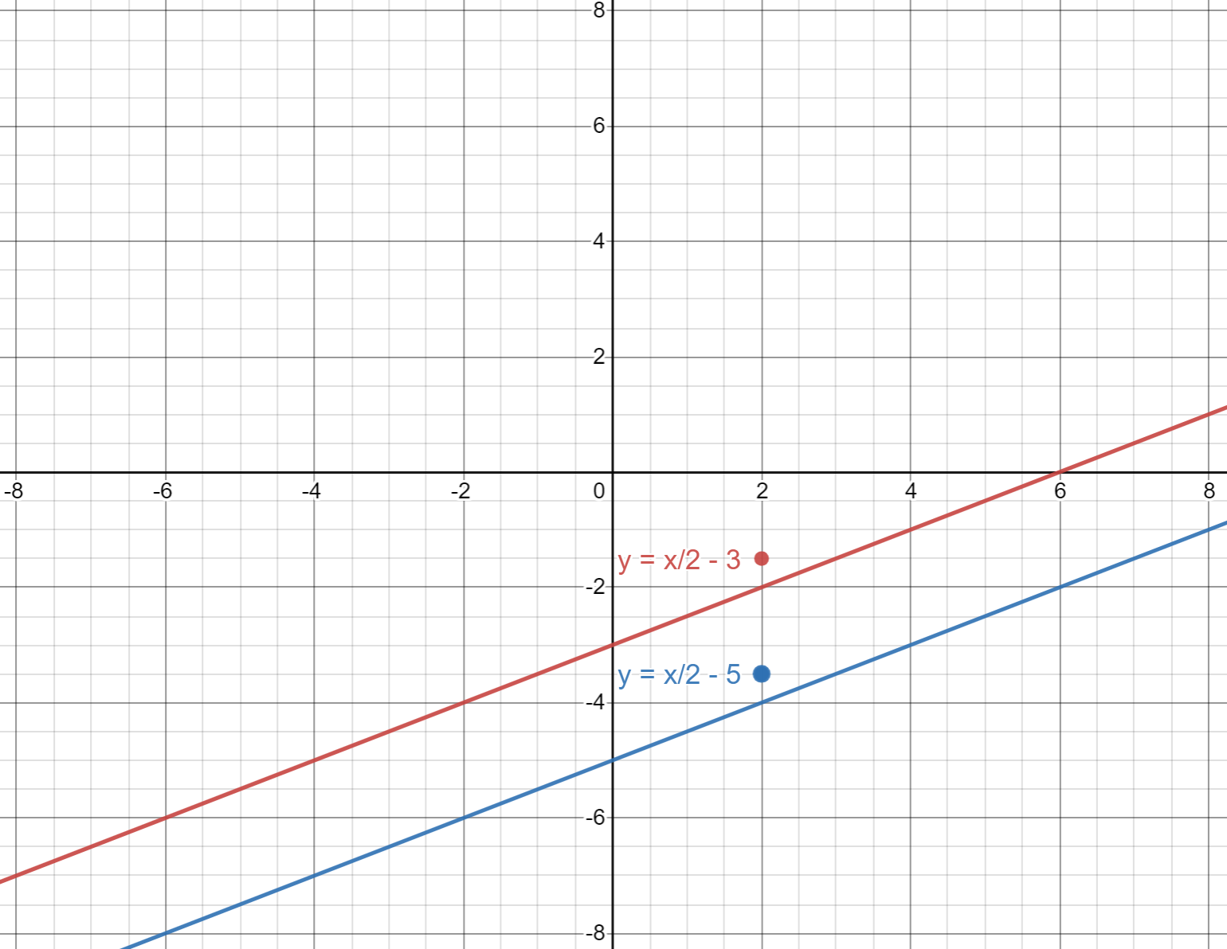
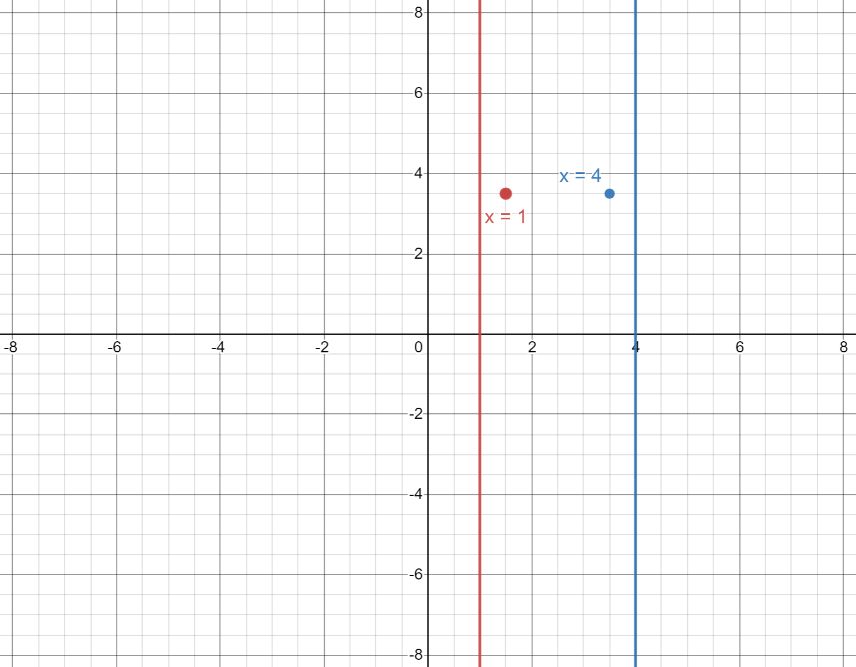
Are these lines Parallel, Perpendicular or Neither?
Parallel
Parallel

Slide 6
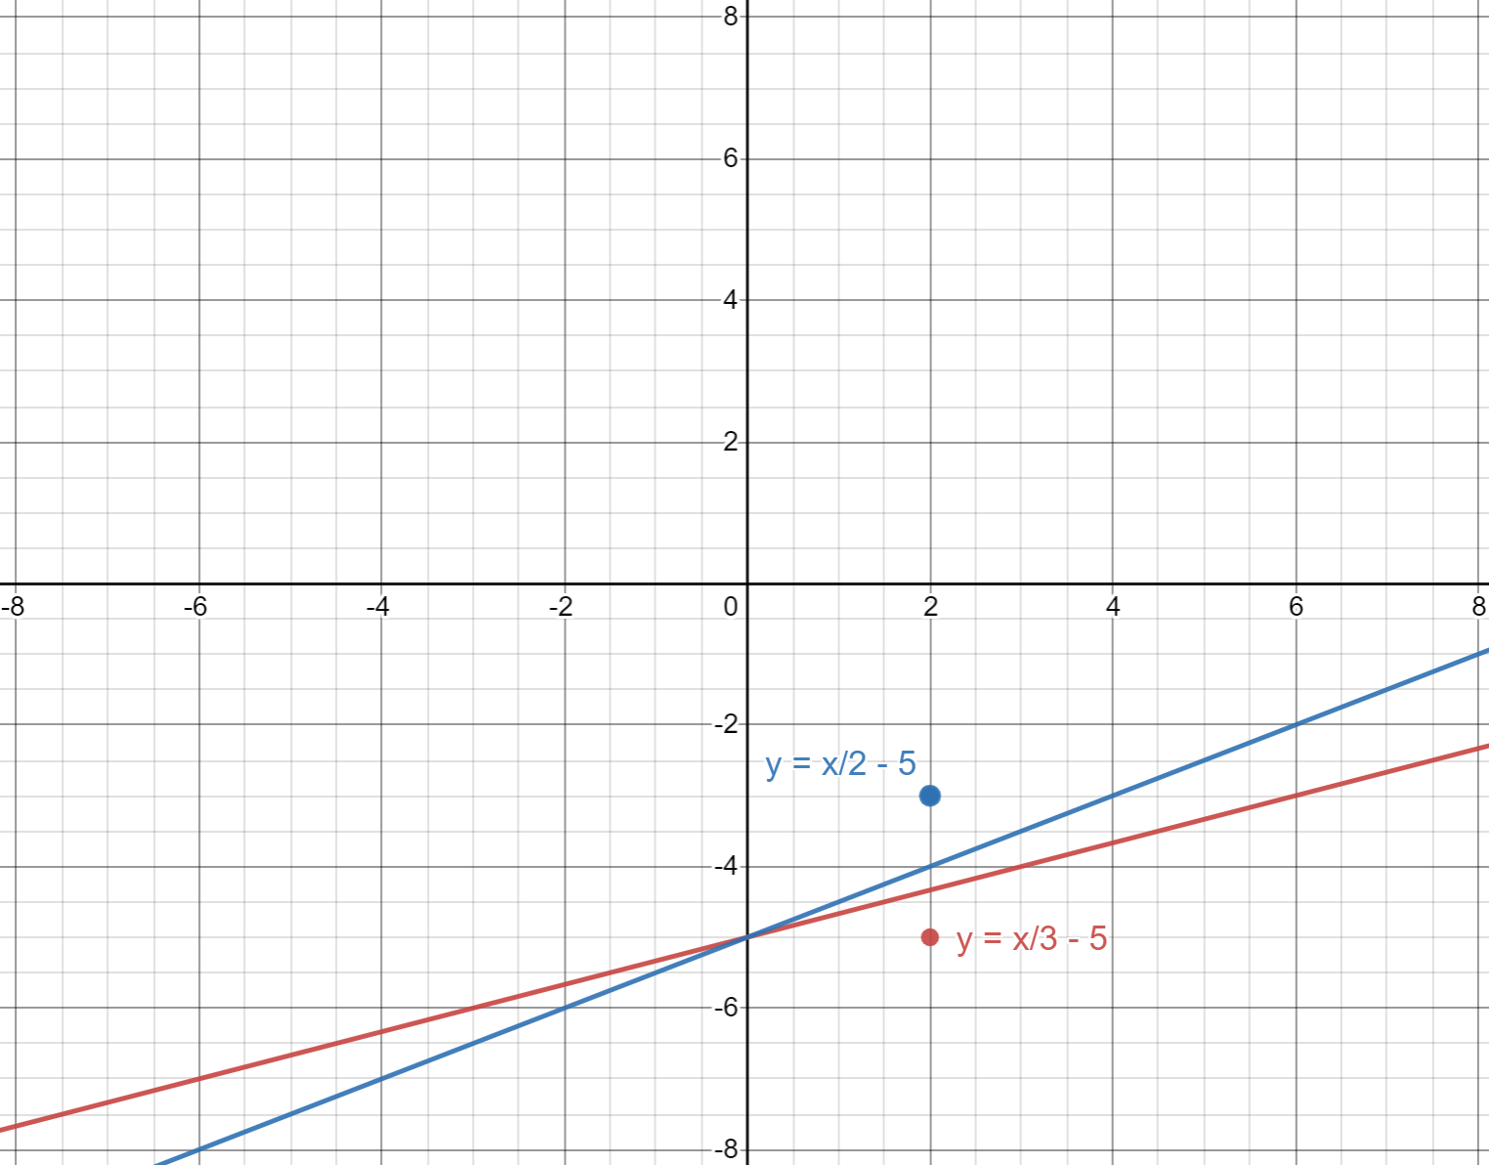
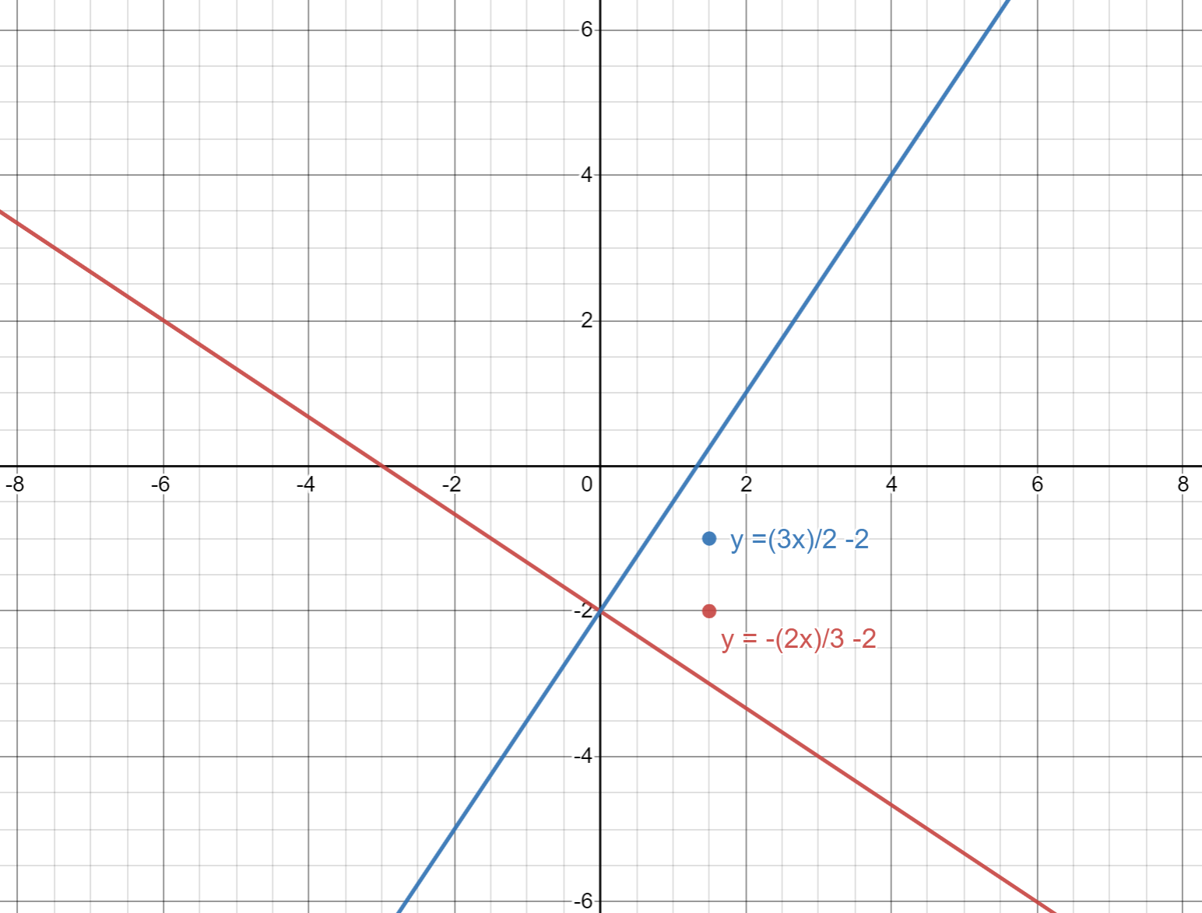
Are these lines Parallel, Perpendicular or Neither?
Neither
Perpendicular

Slide 7
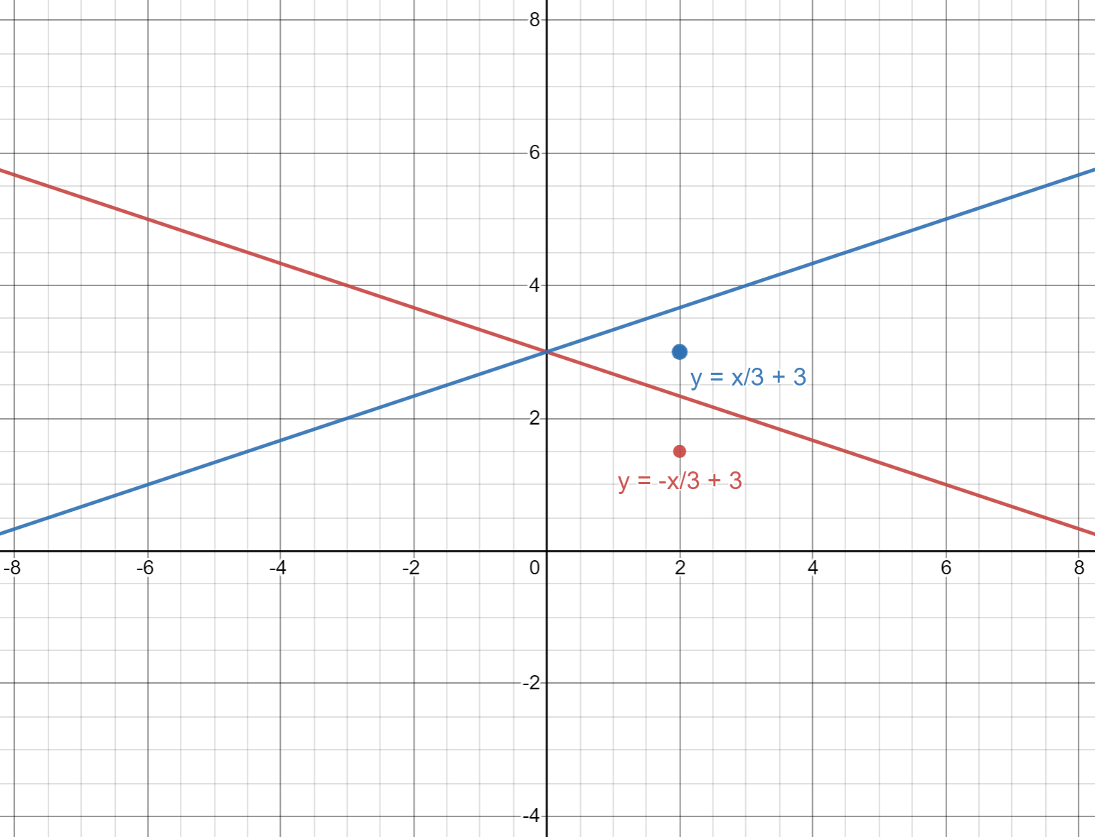
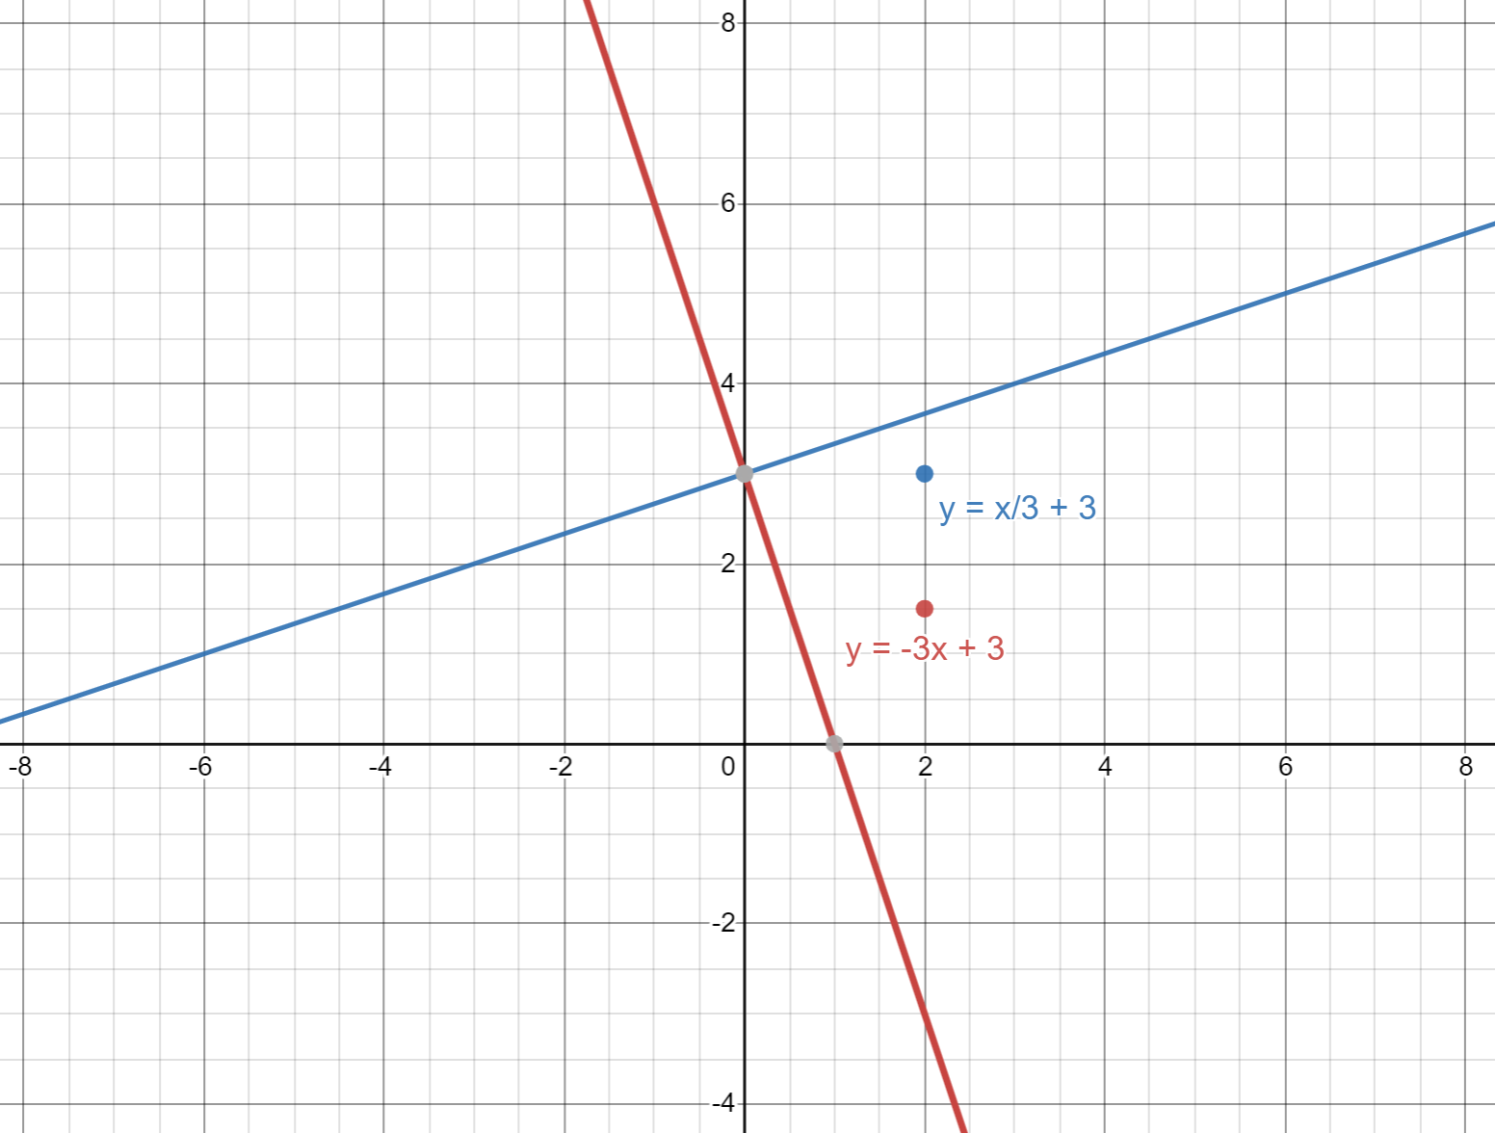
Are these lines Parallel, Perpendicular or Neither?
Neither
Perpendicular

